Slide 1
Socializing for Heuristics
How Social Media Made Me a Better Tester (and Human)

Slide 2
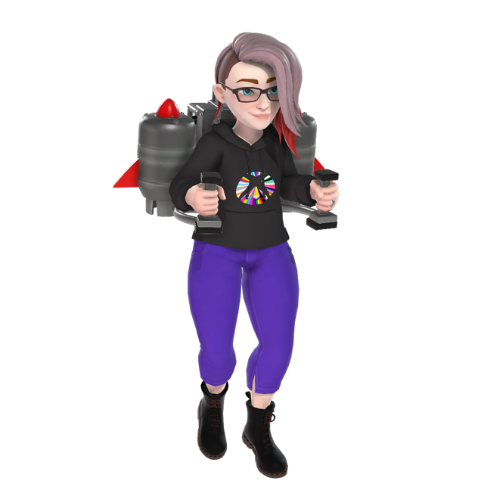


Hello!
Hilary Weaver-Robb
Sr. Quality Engineer, Xbox Studios Quality

Slide 3
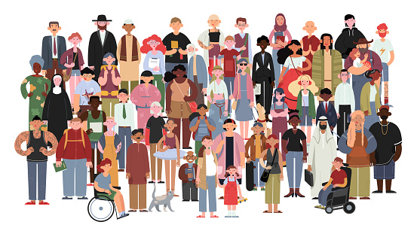
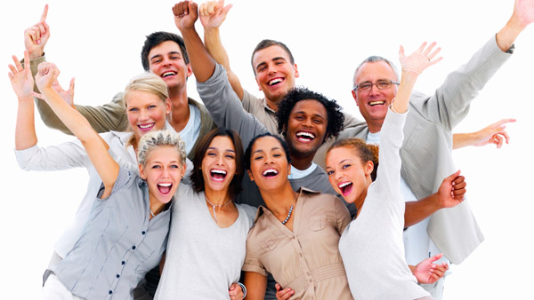
Notes:
https://242community.com/wp-content/uploads/group.jpg
https://media.istockphoto.com/vectors/socially-diverse-multicultural-and-multiracial-people-on-an-isolated-vector-id1152840785?k=20&m=1152840785&s=170667a&w=0&h=RP-O7bUzk-AETqzHBC-hKRDSyt_tNRKausPJeTqZcIc=

Slide 4
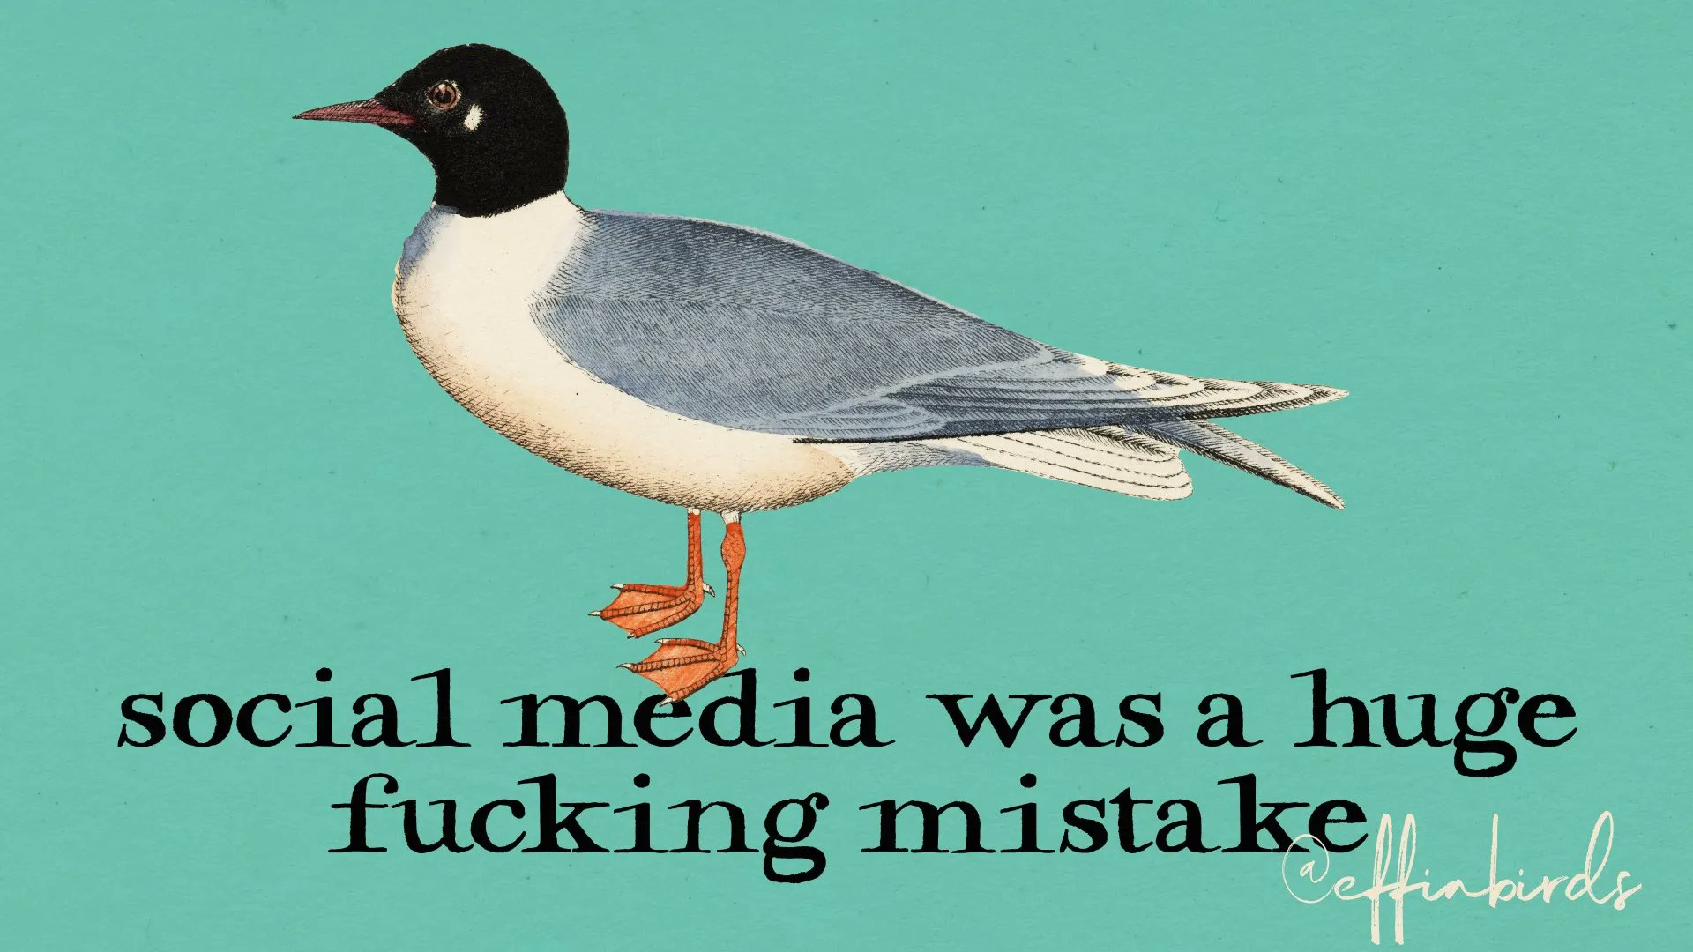

Notes:
https://twitter.com/EffinBirds/status/1574399147054141441/photo/1

Slide 5
Social Media – The Good and The Bad
The Good
Community
The Bad
Trolls
Dog and Cat Videos
Instant sharing of ideas
Instant sharing of ideas
“News” oversaturation

Slide 6
Calling In Not Calling Out
This is about raising awareness, not shaming
If you find yourself feeling uncomfortable, please note:
This is not an attack; this is an invitation to make positive change
Notes:
https://edib.harvard.edu/files/dib/files/calling_in_and_calling_out_guide_v4.pdf?m=1625683246

Slide 7
Overview
Definitions and level-setting
Names
Bodies
Racism, sexism, and other biases
When we got it right
What can I do?

Slide 8
What Are Heuristics?
heuristic adjective
heu·​ris·​tic | \ hyu̇-ˈri-stik
involving or serving as an aid to learning, discovery, or problem-solving by experimental and especially trial-and-error methods
- Merriam-Webster

Slide 9
What Are Heuristics as They Relate to Testing?
“Rough and ready” practical rules or guideposts
Help us find common bugs more quickly
Not foolproof
Can lead to biases

Slide 10
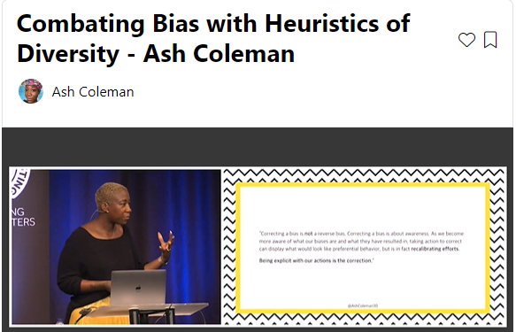
What Are Heuristics as They Relate to Life?
“Rough and ready” practical rules or guideposts
Often translates to stereotypes and bias

Slide 11
Defining ‘Invalid’
invalid adjective
in·​val·​id | \ (ˌ)in-ˈva-ləd
being without foundation or force in fact, truth, or law
- Merriam-Webster

Slide 12
Defining ‘Invalid’
invalid noun
in·​va·​lid | \ ˈin-və-ləd
one who is sickly or disabled
- Merriam-Webster

Slide 13
“People just use Social Media to complain”

Slide 14
Ask Yourself…
“How would I feel if that were me?”
“How would I feel if I ran into that issue all the time?”
“How would it affect my life if every time I interact with software I anticipated a similar issue?”

Slide 15
Names

Slide 16
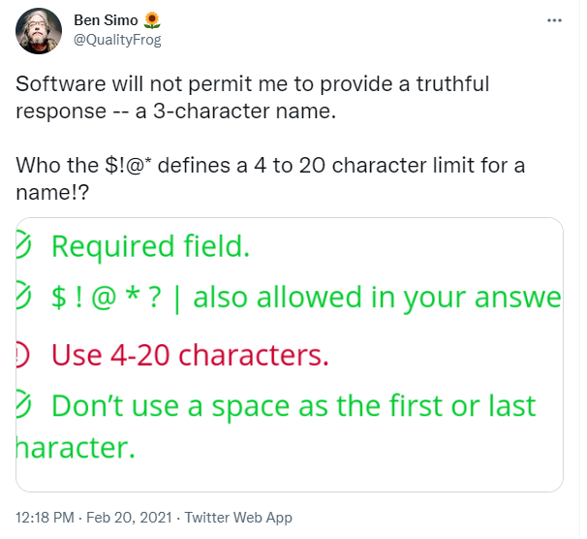
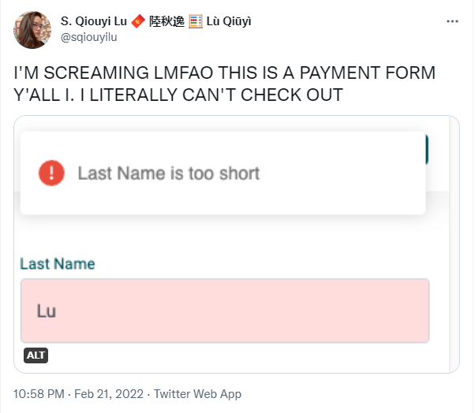
Can a Person’s Name be Invalid?
Notes:
https://twitter.com/qualityfrog/status/1363176335699415040?s=21
https://twitter.com/sqiouyilu/status/1495971335578832898

Slide 17
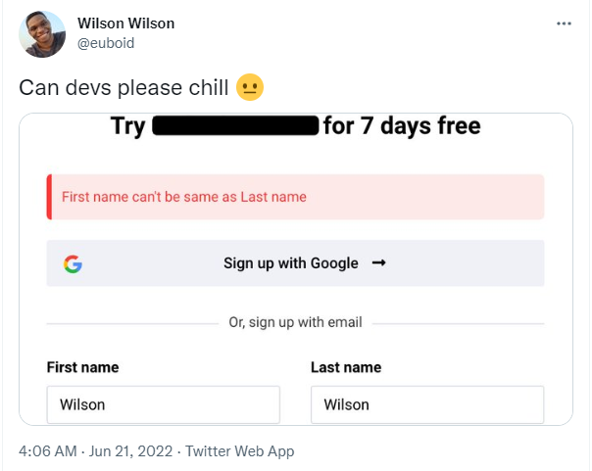
Can a Person’s Name be Invalid?
Notes:
https://twitter.com/euboid/status/1539157673765130240

Slide 18
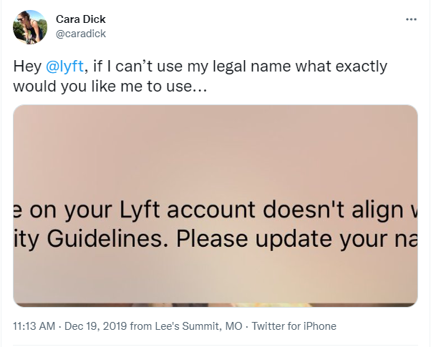
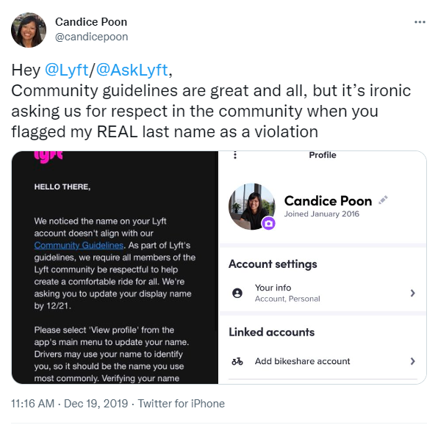
Can a Person’s Name be Invalid?
Notes:
https://www.businessinsider.com/lyft-mistakes-names-community-guidelines-violation-2019-12

Slide 19
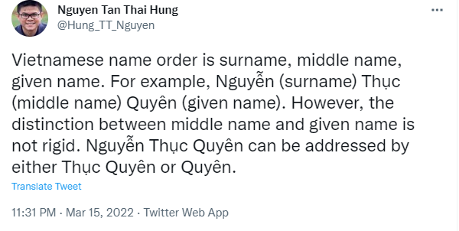
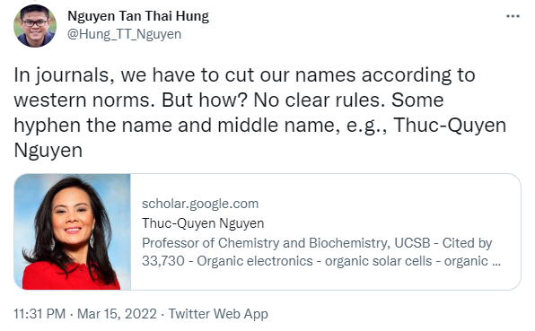
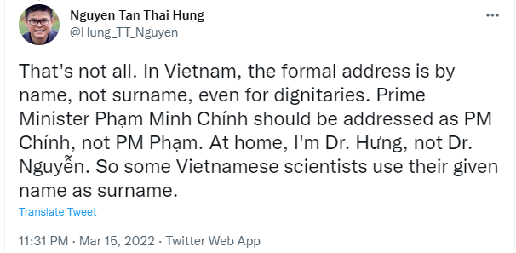
Can a Person’s Name be Invalid?
Notes:
https://twitter.com/Hung_TT_Nguyen/status/1503936865916919813 thread

Slide 20
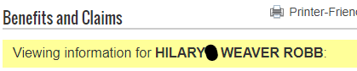
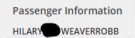
Can a Person’s Name be Invalid?
Weaver-Robb
Weaver Robb
Weaverrobb

Slide 21
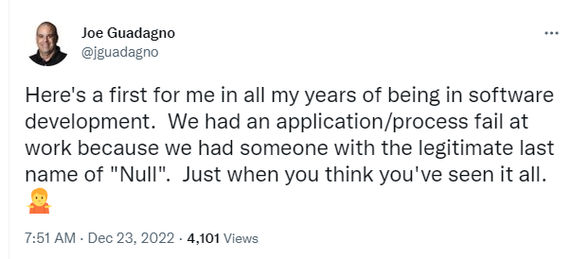
Can a Person’s Name be Invalid?
Notes:
https://twitter.com/jguadagno/status/1606271240972509184?s=46&t=DTtXWeXnrYQYFBnro85pKg

Slide 22
40 Falsehoods
People have exactly one canonical full name.
People have exactly one full name which they go by.
People have, at this point in time, exactly one canonical full name.
People have, at this point in time, one full name which they go by.
People have exactly N names, for any value of N.
People’s names fit within a certain defined amount of space.
People’s names do not change.
People’s names change, but only at a certain enumerated set of events.
People’s names are written in ASCII.
And more
Notes:
https://shinesolutions.com/2018/01/08/falsehoods-programmers-believe-about-names-with-examples/

Slide 23

Updating Our Heuristics
Names
Would I feel excluded with a 1 char name?
Would I feel excluded if my name were censored?
Would I feel excluded if forced to use Western name ordering?
Would I feel excluded if I had “special” characters in my name?
Would I feel excluded if I had to change my name?
Reference the 40 falsehoods

Slide 24
Bodies

Slide 25
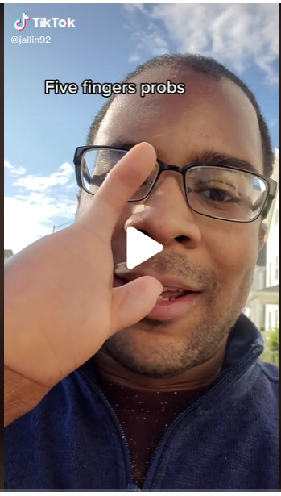
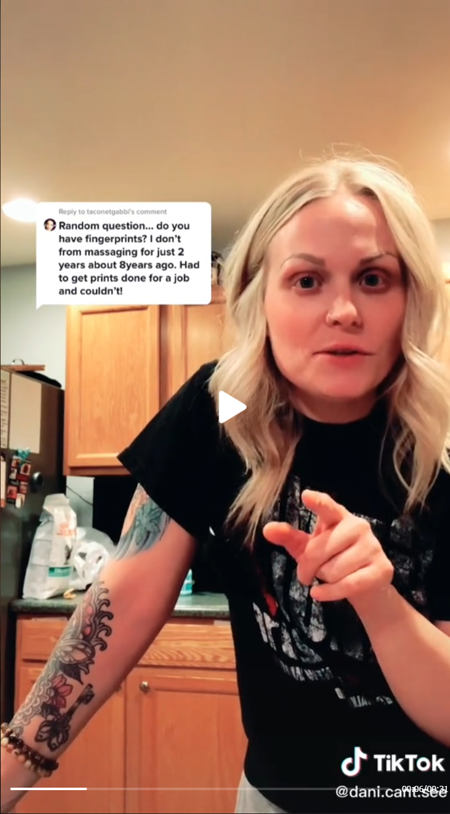
Do Limb or Digit Differences Make You Invalid?
Notes:
https://www.tiktok.com/@jallin92/video/7012682431387929861?is_from_webapp=v1&item_id=7012682431387929861
https://www.tiktok.com/@dani.depictions/video/7047674015636376878?is_copy_url=1&is_from_webapp=v1

Slide 26
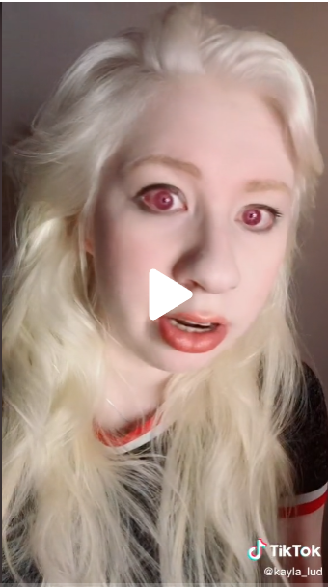
Do Vision Differences Make You Invalid?
Notes:
https://www.tiktok.com/@kayla_lud/video/7101854501413555502?_r=1&_t=8SqEk0TEj2Q&is_from_webapp=v1&item_id=7101854501413555502

Slide 27
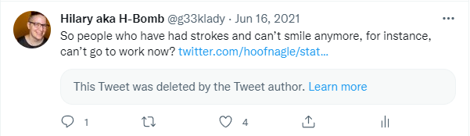
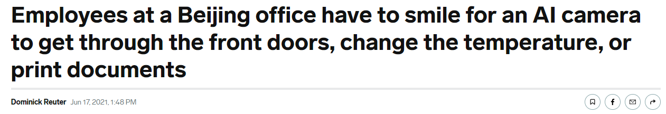
Do Muscle And Nerve Differences Make You Invalid?
Notes:
https://twitter.com/g33klady/status/1405324300404539392
https://www.businessinsider.com/workers-at-chinese-office-have-to-smile-at-ai-camera-2021-6

Slide 28
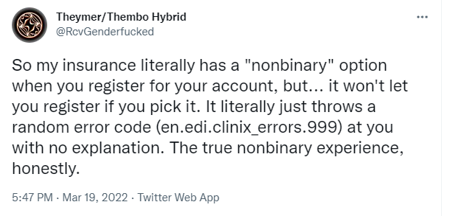
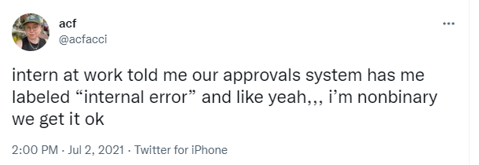
Does Being Outside the Binary Make You Invalid?
Notes:
https://twitter.com/RcvGenderfucked/status/1505299870227341315
https://twitter.com/acfacci/status/1411021862365188102

Slide 29
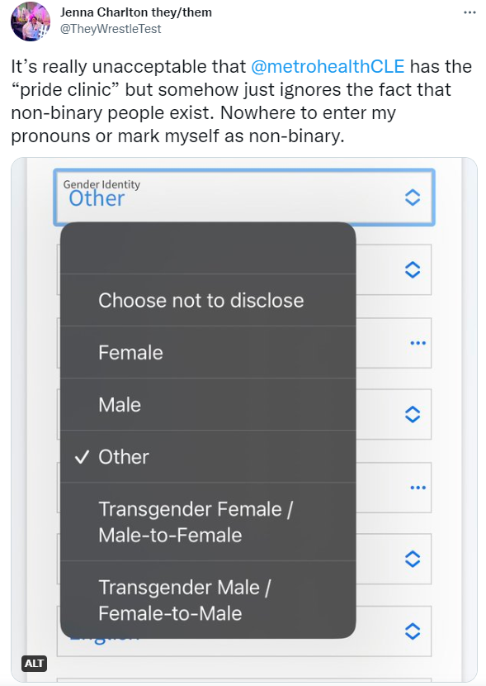
Does Being Outside the Binary Make You Invalid?
Notes:
https://twitter.com/theywrestletest/status/1611032582648467458?s=46&t=vYT2MiPsRxQCX9iOB_lwzQ

Slide 30
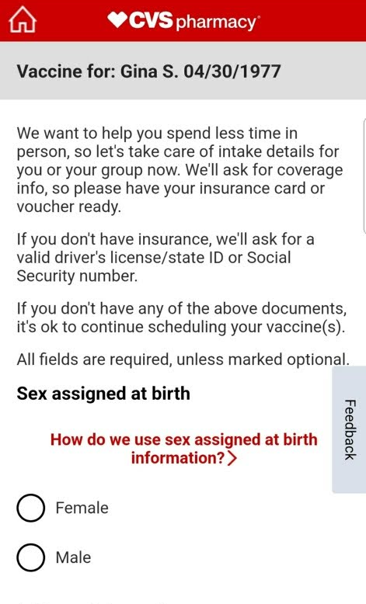
Does Being 1.7% of the Population Make You Invalid?
Notes:
https://www.amnesty.org/en/latest/news/2018/10/its-intersex-awareness-day-here-are-5-myths-we-need-to-shatter/

Slide 31
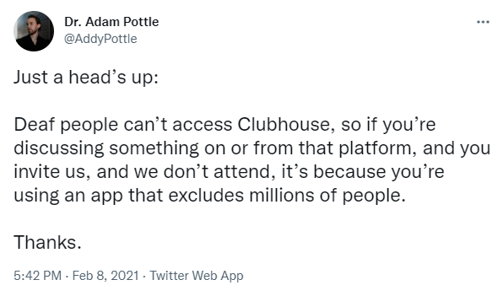
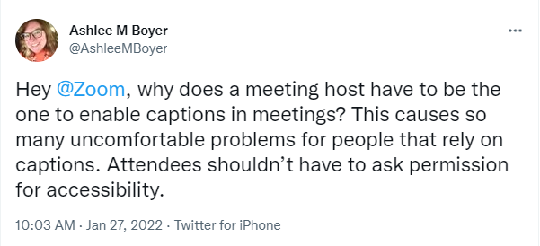
Does being deaf or hard of hearing make you invalid?
Notes:
https://twitter.com/addypottle/status/1358909121769086979?s=21
https://twitter.com/AshleeMBoyer/status/1486716379189235730

Slide 32
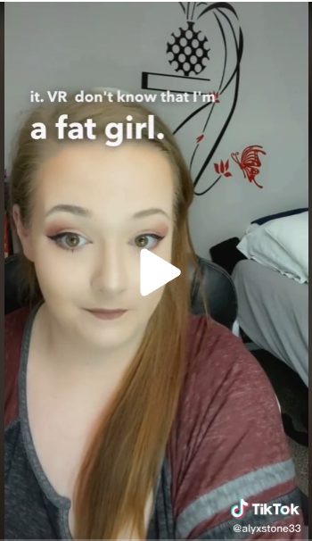
Does Larger Body Size Make You Invalid?
Notes:
https://www.tiktok.com/@alyxstone33/video/6966767940595240198

Slide 33
Updating Our Heuristics
Bodies
Would I feel excluded with a limb/digit difference?
Would I feel excluded if I had to use larger font, had low vision or was blind?
Would I feel excluded if I didn’t fit into the concept of a sex or gender binary?
Would I feel excluded if I was deaf or hard of hearing?
Would I feel excluded if I had a larger body?

Slide 34
Racism, Sexism, and Other Biases

Slide 35
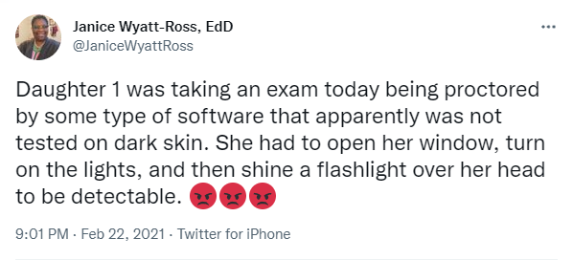
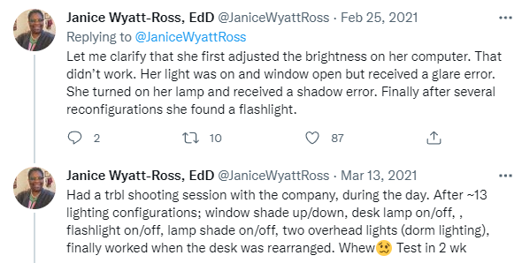
Racist Algorithms
Notes:
https://twitter.com/janicewyattross/status/1364032597484056577?s=21

Slide 36
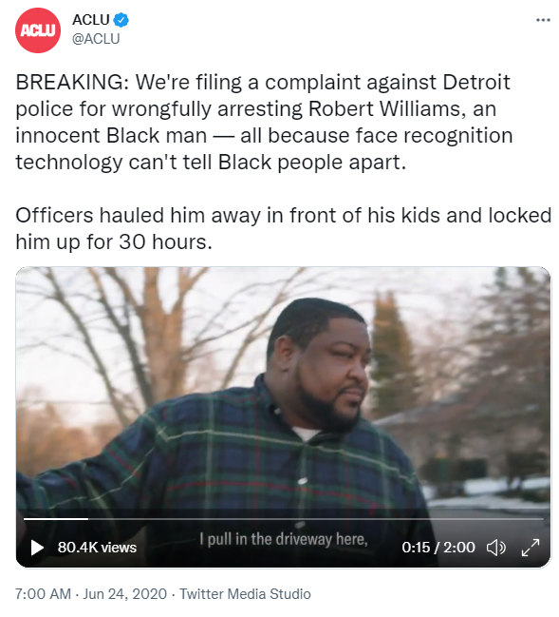
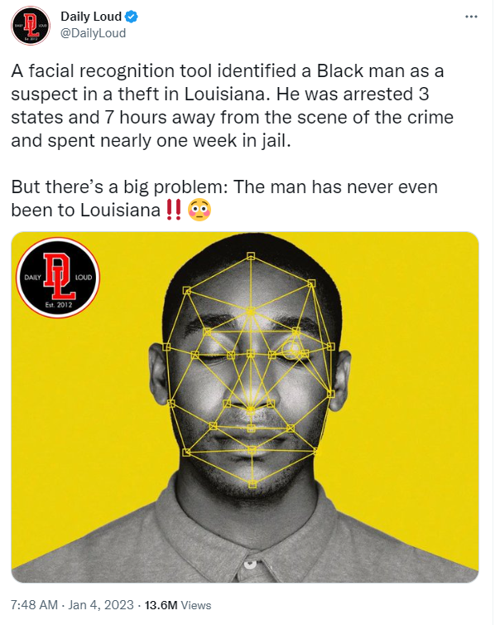
Racist Algorithms
Notes:
https://twitter.com/aclu/status/1275745489544081408
https://twitter.com/DailyLoud/status/1610619169627684866?s=20&t=tbyKnQvUi8A3pk3rz_EapA

Slide 37
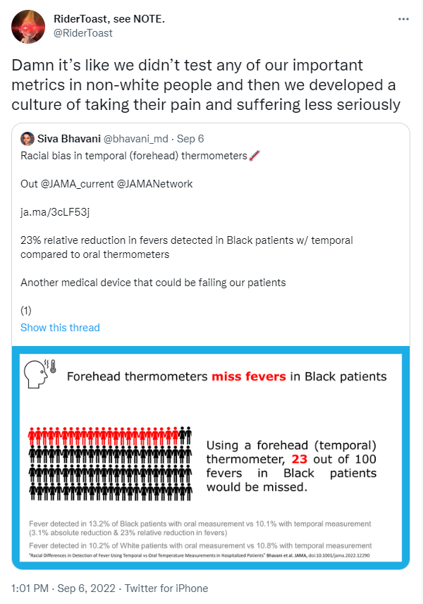
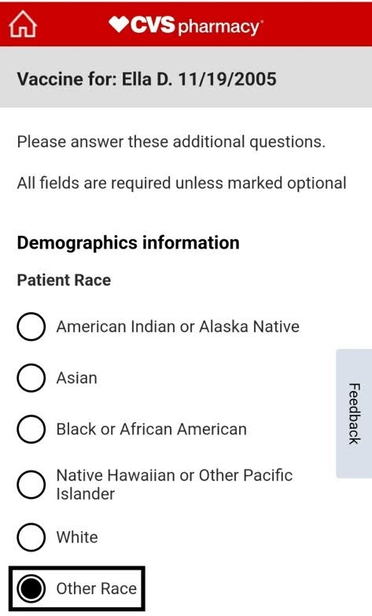
Does Having Non-White Skin Make You Invalid?
Notes:
https://twitter.com/RiderToast/status/1567196329146720259

Slide 38
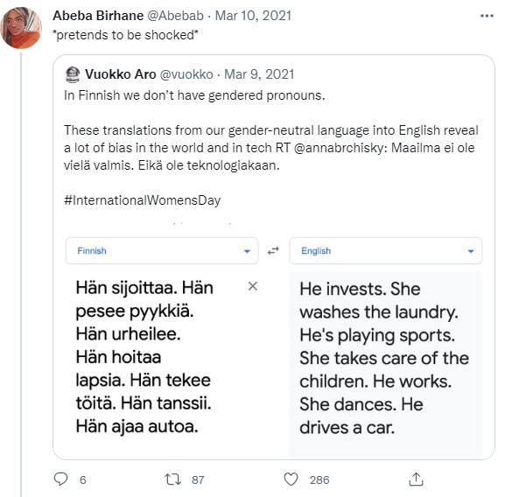
Sexist Algorithms
Notes:
https://twitter.com/Abebab/status/1373380442989158402

Slide 39
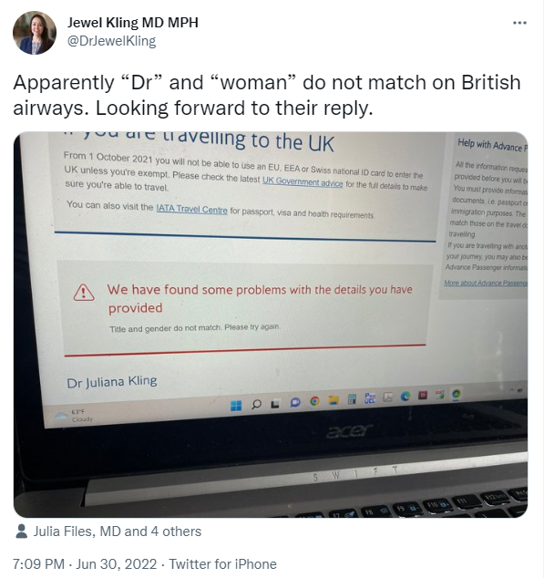
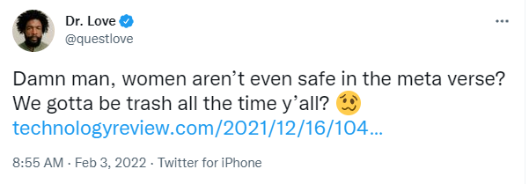
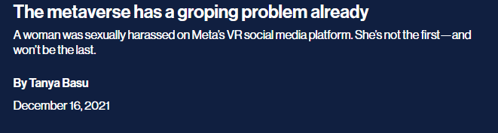
Biased Teams
Notes:
https://twitter.com/drjewelkling/status/1542646473208348672?s=21&t=uCSIEV-pcE2RlT_dKKI19g
https://twitter.com/questlove/status/1489236087868465152
https://www.technologyreview.com/2021/12/16/1042516/the-metaverse-has-a-groping-problem/amp/

Slide 40
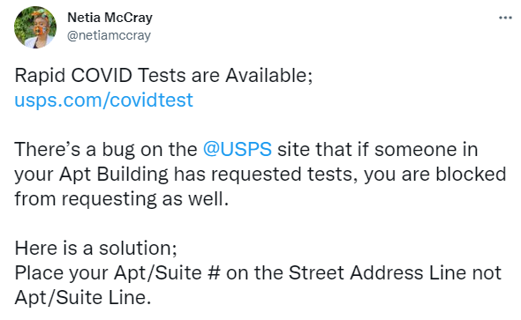
Other Biases
Notes:
https://twitter.com/netiamccray/status/1483516011357868038

Slide 41
Updating Our Heuristics
Racism/Sexism/Other
Would I have a harder time using the software because I’m not white?
Would I suffer personal or financial freedom if I wasn’t white?
Would I feel excluded if I wasn’t white or was mixed-race?
Would I have a harder time using the software because I’m not male?
Would I feel excluded or unsafe if I wasn’t male?
Would I feel excluded if I lived in a multi-family home?

Slide 42
When We Got It Right

Slide 43
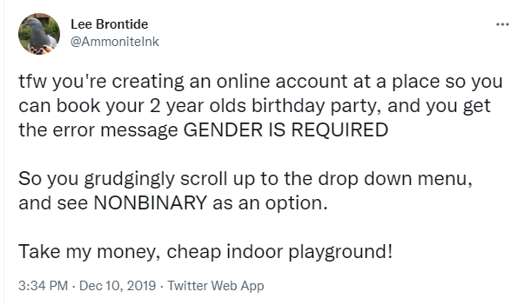
Gender Inclusivity
Notes:
https://twitter.com/AmmoniteInk/status/1204499727573798912

Slide 44
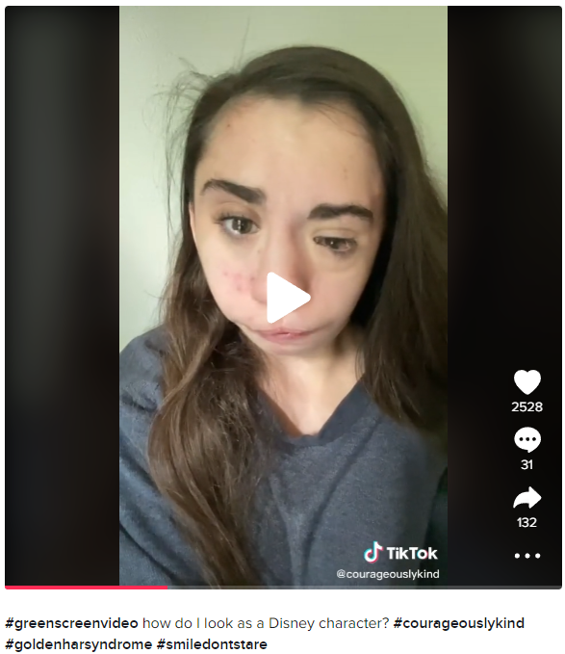
Face Difference Inclusivity
Notes:
https://www.tiktok.com/@courageouslykind/video/6973709115168230662?is_from_webapp=v1&item_id=6973709115168230662

Slide 45
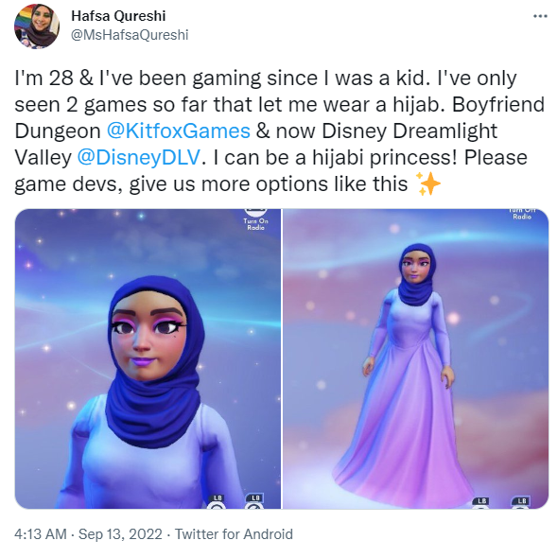
Religious Inclusivity
Notes:
https://twitter.com/mshafsaqureshi/status/1569600239916433409?s=46&t=noRptDwUOSH5pBkX-mt7wQ

Slide 46
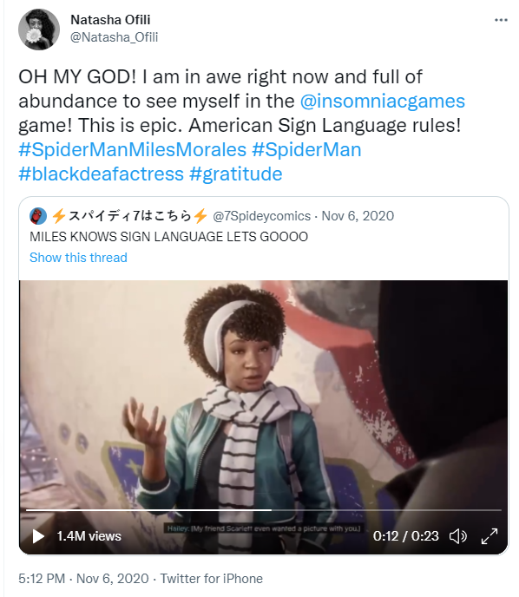
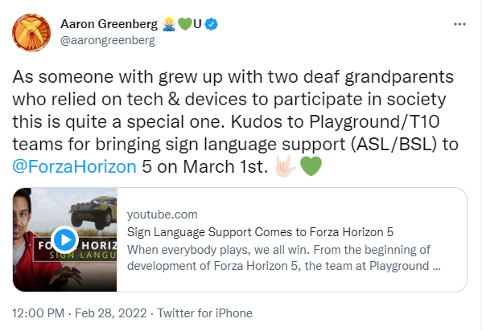
Disability Inclusivity
Notes:
https://twitter.com/Natasha_Ofili/status/1324837179525226496?s=20
https://twitter.com/aarongreenberg/status/1498342468093235201

Slide 47
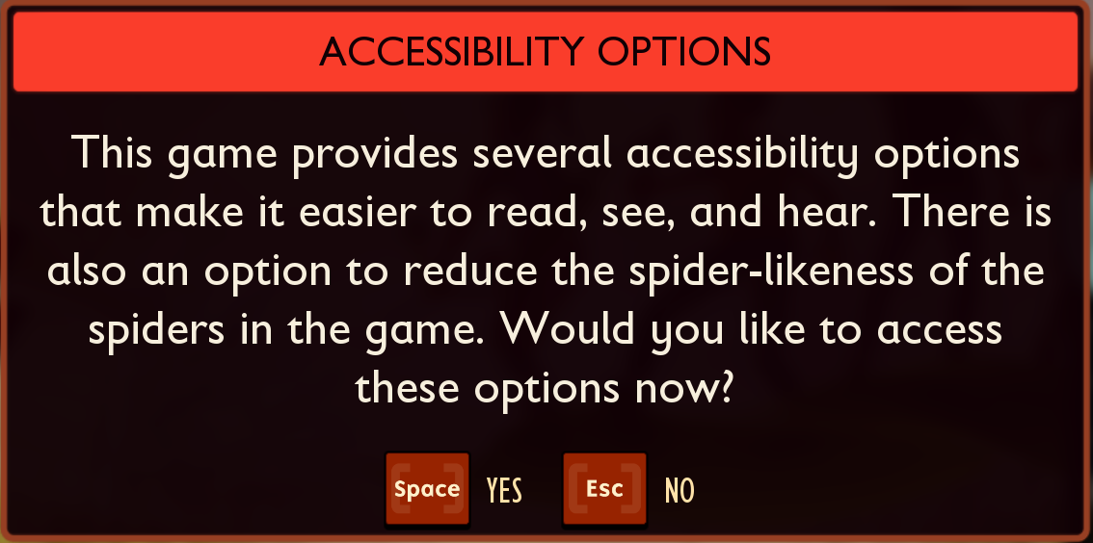
Phobia Understanding
Notes:
Screenshot from Grounded game on Xbox Game Pass

Slide 48
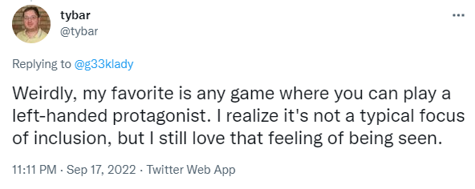
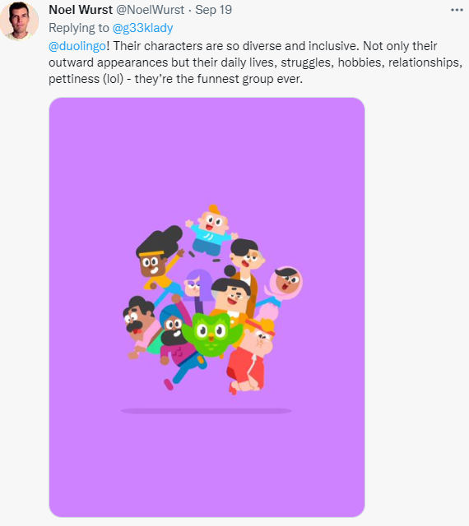
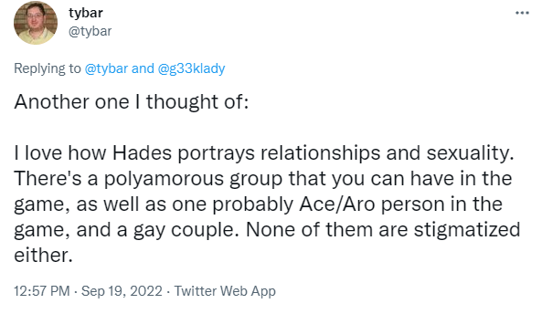
Real Life Inclusivity
Notes:
https://twitter.com/tybar/status/1571906216775000065
https://twitter.com/tybar/status/1571336184554729473
https://twitter.com/NoelWurst/status/1571893837517160452

Slide 49
Common Theme
Inclusion

Slide 50
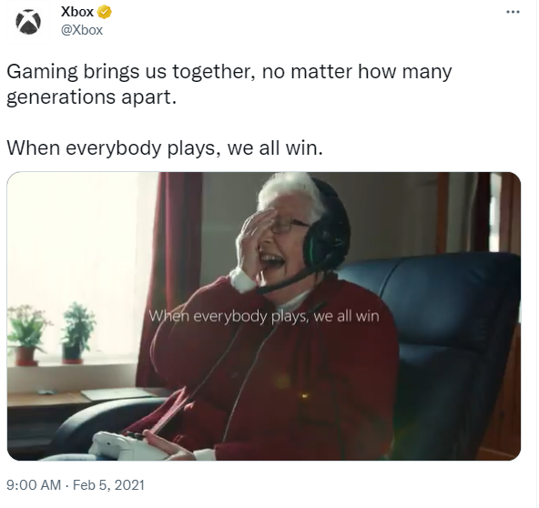

Notes:
https://twitter.com/xbox/status/1357690442553434114

Slide 51
Updating Our Heuristics
Would I feel included if I was:
Not white
Not male
Not cis gendered
Disabled
Not Christian
Not “Western”
Not heterosexual
Left-handed
“Too young” or “too old”

Slide 52
What Can I Do?

Slide 53
How Can We Make Our Software Better For Everyone?
Broaden your worldview
Advocate for inclusion
Diversify tech

Slide 54
Broaden Your Worldview
Take a look at who you’re following and listening to
Do you follow users of your software?
Check your biases
Fill the gaps intentionally!
Who do they follow?
What do they share?
Join ANY available Employee Resource Groups

Slide 55
Advocate For Inclusion
How diverse is your team?
Test for exclusion and report bugs
Use these heuristics earlier, in planning
Use diverse personas
Involve ERGs or DEI if you want feedback
Question your assumptions

Slide 56


Diversify Tech
“Pipeline problem” is
If you’re involved in interviews
Educate yourself
Adjust the process
Diversity AND Inclusion

Slide 57
A Note About Mastodon
Distributed networks are not intersectional by nature
Me on Mastodon
Disability server
LGBTQ+ server
Antiracism server
Software Testing server
Twitter, TikTok, Instagram, etc
Disability
LGBTQ+
Antiracism
Software Testing

Slide 58
Resources
Slides with links to each social media post
List of resources mentioned
List of folks to follow to diversify your feed
Diversifying heuristics cheat sheet
g33klady.com/DiversifyingHeuristics

